Slide 1
Victims Advocate
Natalie Queiroz MBE – Victims Advocate, West Midlands Office of Police and Crime Commissioner

Slide 2
NOBODY CHOOSES
TO BECOME A
VICTIM
BEING A VICTIM DOES NOT MEAN YOU:
  ARE WEAK
  ARE TO BLAME
  VICTIMS ARE NOT BORN - THEY ARE MADE THROUGH THE ACTIONS OF A PERSON OR A CIRCUMSTANCE
  VICTIMS NEED UNDERSTANDING,SUPPORT AND EMPATHY..
  VICTIMS NEED EMPOWERMENT
Notes:
We mustn’t forget this as we go through today

Slide 3

My Victim-Survivor- Thriver Journey
2016
2017
2018
2019
2020
2021
2022
2023
2024
  ATTEMPTED DOMESTIC HOMICIDE WHILST 8 MONTHS PREGNANT
  FOUND MY VOICE – PUBLISHED AUTHOR, TEDX SPEAKER & SOCIAL ENTERPRISE FOUNDER (YOUTH VIOLENCE)
  COMPLETED RESTORATIVE JUSTICE
ACTIVE VICTIMS CAMPAIGNER
  SUCCESSFULLY CHALLENGED THE CICA FOR MY ‘IN UTERO’ BABY
  MBE - SERVICES TO YOUNG PEOPLE & PREVENTION OF KNIFE CRIME
  QUALIFIED SPECIALIST WORKING WITH GANGS & YOUTH VIOLENCE
  ACCEPTANCE OF BEING A DA SURVIVOR & BECAME AN AMBASSADOR
  EXPANEDED PRISON WORK TO 10 PRISONS – BROAD KNOWLEDGE
Notes:
This is the highlights – the positive of my timeline but not seen in all of this are those feelings of scrutiny, isolation, guilt, shame and stigma – especially highlighted by the fact I didn’t accept that I was a victim of DA until 2020 as I was so paralysed by the label of it. It becomes part of the recovery to mask those underlying feelings so often.
But taking the beginning of that journey – 2016.. A happy safe world turned into a horror show in moments and the world turned upside down. No choice, but thrown into the..

Slide 4
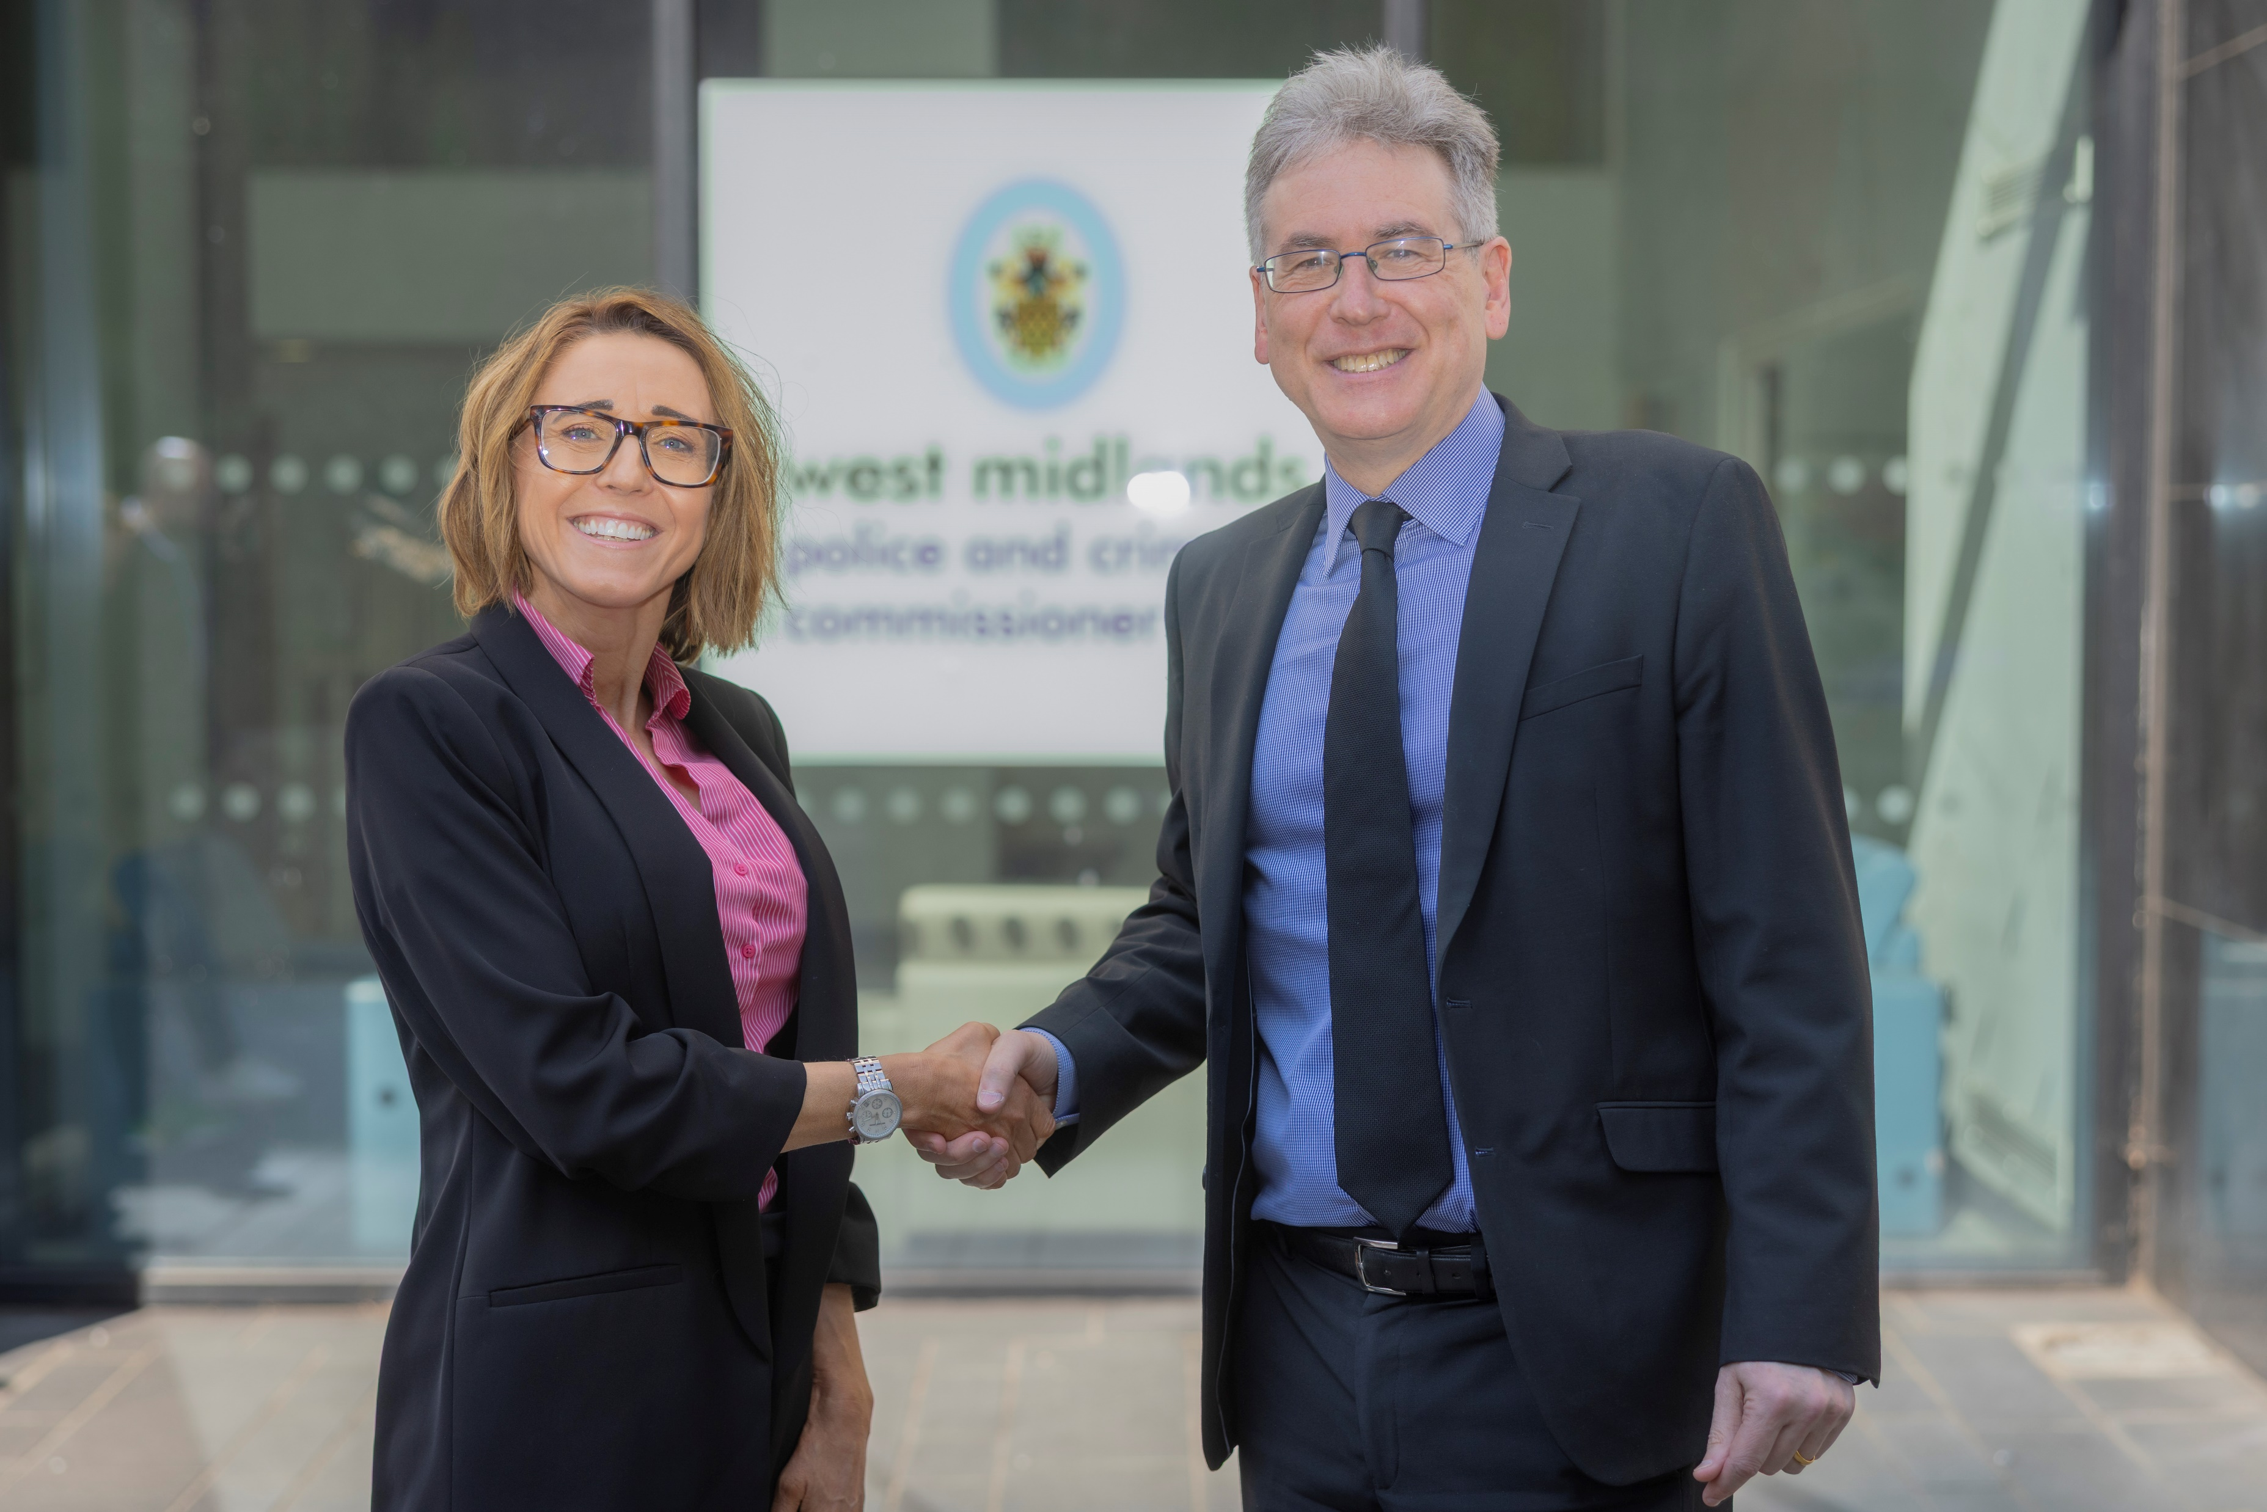
2025: West Midlands PCC Victims Advocate
I will insure the voice of the victim is heard, that
the Police & other Criminal Justice Agencies
are held accountable.
Be that ‘Critical Friend’ to ensure all services do
their best for victims within our region - regardless of the crime, regardless of the victim’s background.
Uphold the Victims Code & ensure Victims know their rights & receive the support they should.
The Victim is at the heart of whatever I do

Slide 5


Slide 6
First 90 Days.. Overview
Built Relationships with and Developed Understanding/Awareness of West Mids Police
  Meetings with ALL Senior Police Officers – Chief, Deputy Chief, Assistant Chiefs
  Spent a day with each of our Public Protection Units (PPU)
  Visited one of our Custody Blocks
  Sat in one of our Stalking Triage meetings
  Met the Roads Victims Team
Met with all our Commissioned Services
  Group meetings
  1:1 meetings with CEOs/Teams
  In person visits

Slide 7
First 90 Days.. Overview
Meetings with our Criminal Justice Partner Agencies
  CPS
  HMCTS
  HMPPS
Met with other Commissioners, MPs and Ministers
Casework and Victim ‘learning’ meetings
Arranged / Led on England and Wales’ Domestic Abuse Commissioner visit - Dame Nicole Jacobs
  2 roundtable meetings with our office, WMP and our specialist ‘by and for’ support services
Led on Advisory Panel focussed on Victims Code Awareness

Slide 8
First 90 Days.. Overview
Chair
  Victims Commission Meeting
  Victims and Witnesses Delivery Board
Regular Meeting Commitments
  Accountability and Governance Board (monthly)
  Local Criminal Justice Board
Opening speaker
  Women’s Justice Board meeting
  Spotlight on Stalking Seminar
  Spiking Conference

Slide 9
Glimpse of Future Focus..
Victim Voice work – already started
Identify and set action plan with all CJS agencies on how to improve Victim Code Compliance and in turn, most importantly, improve victim's journey through the system
Lead on the plan to inform and empower ALL our communities with respect to their Victim's rights (VCOP Comms Plan)
Lead West Midlands to be best region to support victim’s access to justice and support (which will improve our criminal justice outcomes)
Continue to build on national relationships – Ministers, National Commissioners, MoJ
Make sure West Midlands have input and visibility on the national picture to shape directives and decisions affecting victims from a Government perspective
Continue to develop Victim and Witness Delivery Group and Victim Commission meetings

Slide 10
Thank you
- Questions?

